Slide 1
Links and Navigation In HTML

Slide 2
Links and Navigation
What really distinguishes the Web from other mediums is the way in which Web pages can contain links that take you directly to other pages (and even specific parts of a given page). Known as hyperlinks, these links are often attributed to being the secret behind the Web’s phenomenal success.
Hyperlinks allow visitors to navigate between Web sites by clicking on words, phrases, and images.

Slide 3
Basic Links
A link is specified using the <a> element.
Anything between the opening <a> tag and the closing </a> tag becomes part of the link a user can click in a browser.

Slide 4
Linking to Other Documents
To link to another document, the opening <a> tag must carry an attribute called href, whose value is the
page you are linking to.
As an example, here is the <body> of a document called ch03_eg01.html. This page contains a link to
a second page called index.html:
<body>
Return to the <a href="index.html">index page</a>.
</body>

Slide 5
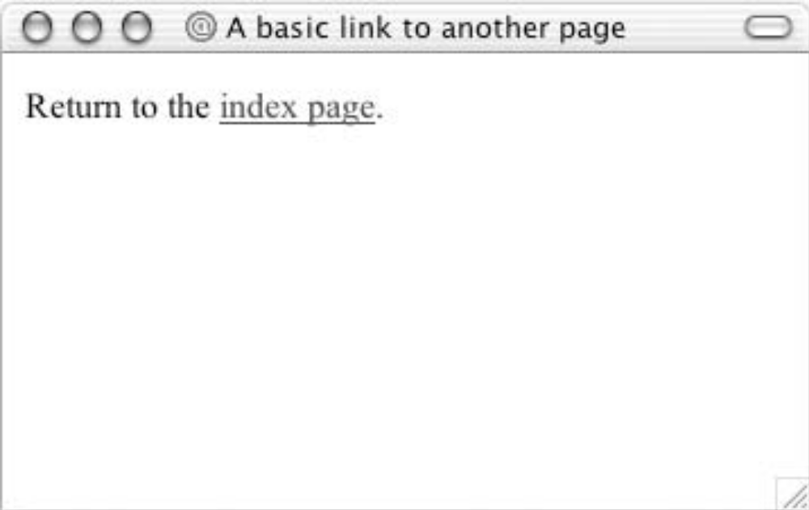
Output:

Slide 6
Types of Hyperlink
Hyperlinks can be of two types:
Link to some other web page
Links to the external document.
Link to a specific place within the same document.

Slide 7
External Document Reference

Slide 8
Link to a different site:
If you want to link to a different site, you can use the following syntax, where you specify a full URL (Uniform Resource Locator) to the page you want to link to rather than just the filename.
<body>
Why not visit the <a href="http://www.wrox.com/">Wrox Web site</a>?
</body>

Slide 9
Title attribute
It is also good practice to use the title attribute on a link, as this will be displayed in a tool tip (a little
bubble that appears stating the title) in most visual browsers when the user hovers over the link.
This can help the visually impaired if they use a voice browser.
The value of the title attribute should be a description of what the link will take you to. They are especially important if you use an image for a link.

Slide 10
example,
Here is a link to the Google home page.
<a href="http://www.Google.com/" title="Search the Web with Google"> Google</a>is a very popular search engine.

Slide 11
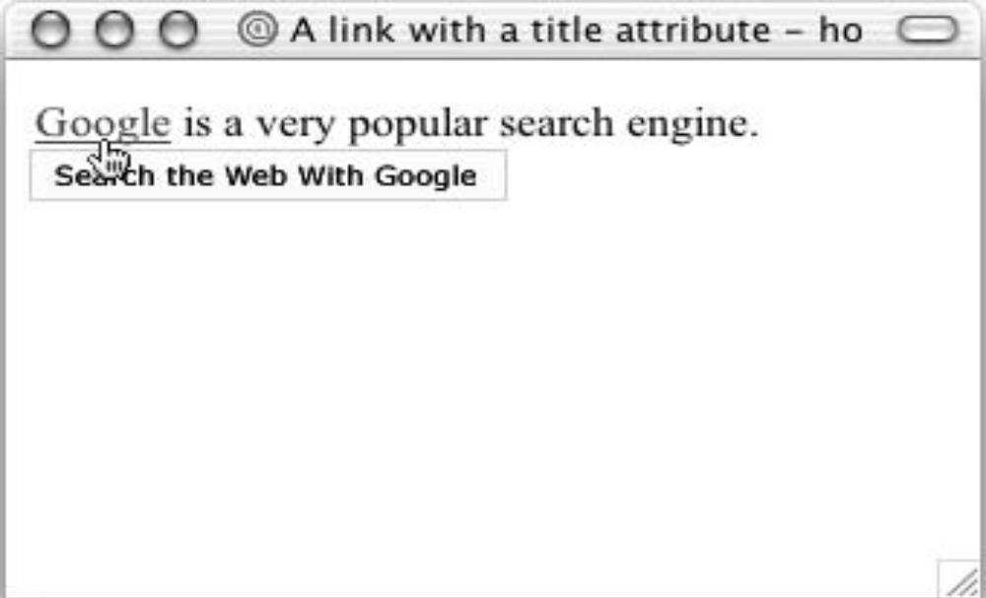
Output

Slide 12
Linking to E-mail Addresses
To create a link to an e-mail address you need to use the following syntax with the <a> element:
< a href="mailto:name@example.com">
name@example.com</a>
Here, the value of the href attribute starts with the keyword mailto, followed by a colon, and then the e-mail address you want the mail sent to.

Slide 13
Linking to E-mail Addresses
As with any other link, the content of the <a> element is the visible part of the link shown in the browser, so you might choose to use the following:
<a href="mailto:name@example.com">E-mail us</a>.
Or, if you want users to see the e-mail address before clicking it, you can use the following:
For sales enquiries e-mail <a href="mailto:name@example.com">sales@example
.com</a>.

Slide 14
Images As Hyperlinks

Slide 15
Images as hyperlinks
Just as text act as a hyperlink, in the same way images can also act as hyperlinks.
Anything included within the <A>…</A> tags become hyperlink
Image can be made hyperlinks by enclosing image tag within <A>…</A>tags.
  Syntax:
  <A href=“my_site” ><img src=“img1.gif”></A>

Slide 16
MARQUEE TAG: BEHAVIOR
<FONT SIZE="4" FACE="courier" COLOR=blue><MARQUEE WIDTH=“100%” BEHAVIOR=“ALTERNATE” bgcolor=“yellow”>This is an example of an alternating marquee...</MARQUEE></FONT>
<FONT SIZE="4" FACE="courier" COLOR=blue><MARQUEE WIDTH=100% BEHAVIOR=SCROLL bgcolor=yellow LOOP=3>This is an example of a scrolling marquee...</MARQUEE></FONT>

Slide 17
MARQUEE TAG : DIRECTION
<FONT SIZE="4" FACE="courier" COLOR=blue><MARQUEE WIDTH=100% BEHAVIOR=SCROLL DIRECTION=RIGHT BGColor=yellow>This is an example of a marquee scrolling to the right...</MARQUEE></FONT>
<FONT SIZE="4" FACE="courier" COLOR=blue><MARQUEE WIDTH=100% BEHAVIOR=SCROLL DIRECTION=RIGHT BGColor=yellow>This is an example of a marquee scrolling to the right...</MARQUEE></FONT>

Slide 18
MARQUEE TAG : SIZE
<FONT SIZE="4" FACE="courier" COLOR=blue><MARQUEE BEHAVIOR=SCROLL HEIGHT=25 WIDTH=300 BGColor=yellow>This is an example of a scrolling marquee</MARQUEE></FONT>

Slide 19
TABLE TAG
<table cellpadding="10" cellspacing="10" align="center" border="3" bordercolor="cyan">
<tr>
<td>A</td>
<td>B</td></tr>
<tr>
<td>C</td>
<td>D</td>
</tr>
</table>

Slide 20
MARQUEE TAG : SIZE
<FONT SIZE="4" FACE="courier" COLOR=blue><MARQUEE BEHAVIOR=SCROLL HEIGHT=25 WIDTH=300 BGColor=yellow>This is an example of a scrolling marquee</MARQUEE></FONT>

